Slide 1
H.263 Media Compression Broadcast on FPGAs
Final Demo
Group 4

Slide 2
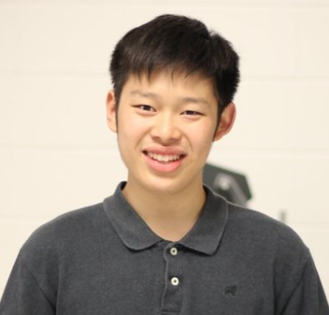


Group Members
Justin Hai (Eng Sci)
Bob (Yufeng) Zhou (Eng Sci)
Isamu Poy (ECE)
Hardware Modules of Compression
FPGA to FPGA networking
Embedded Programming and Integration

Slide 3
Project Summary

Slide 4

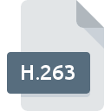
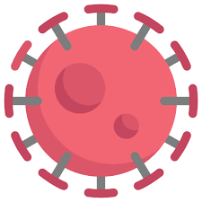

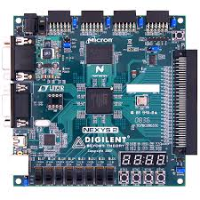

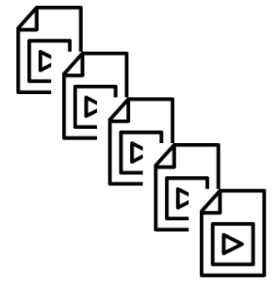

About the Project
Why Compression?

Slide 5
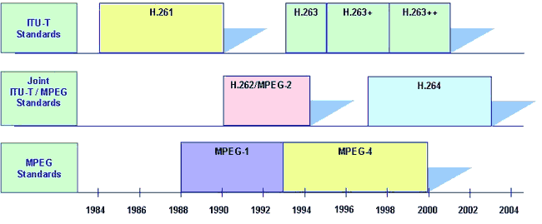
About the Project
What is H.263?
What is Video Codec?
compresses and decompresses digital video
What is special about H.263?
H.263 is optimized for low data rates
Better quality than H.261
H.263 is an advancement of the H.261

Slide 6
Initial Project Goals
vs Final Project Demo

Slide 7
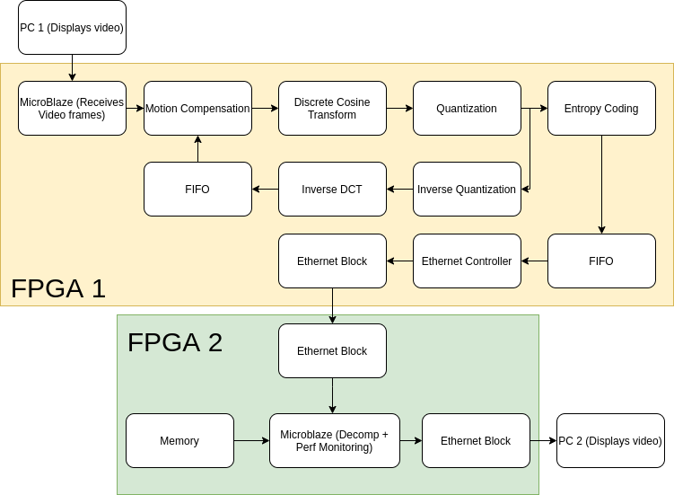
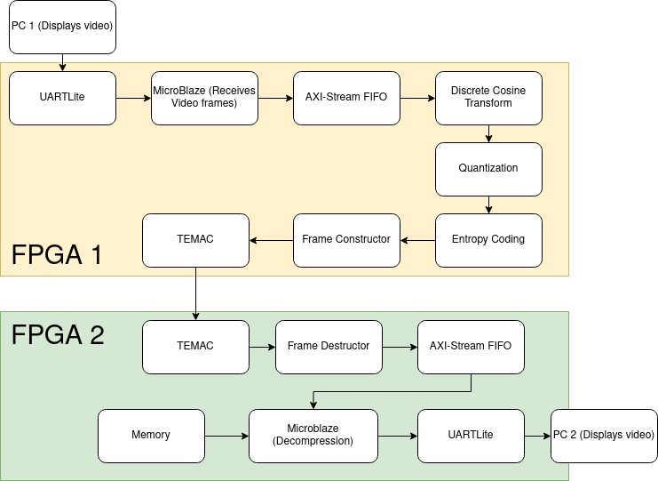
Initial Goals vs Final Demo (Overall System Block Diagram)
Initial
Final
Reason: Lack of time + implementation details

Slide 8
Initial Goals vs Final Demo (DCT)
Reason: Lack of Need

Slide 9
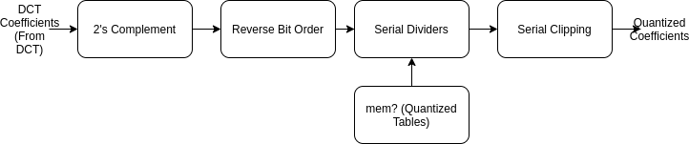
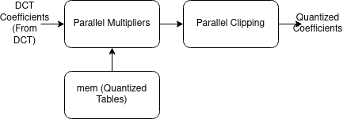
Initial Goals vs Final Demo (Quantizer)
Reason: Unnecessary + Performance

Slide 10
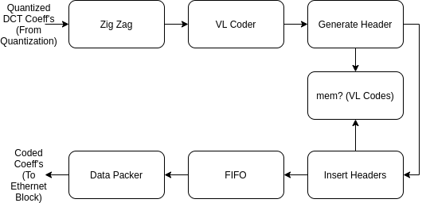
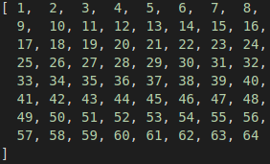


Initial Goals vs Final Demo (Encoder)
Reason: Lack of time, unnecessary

Slide 11
Initial Goals vs Final Demo (Other Changes)
Switched to Fixed Point Arithmetic rather than Floats
Reason: Floats take up more memory, which is not abundant on FPGA
Demo with 1 image rather than a demo
Reason: Time constraints, and showing functionality with 1 image means that it will work with video frames, since that will be just a collection of images
Switched to using TEMAC adapter rather than Ethernet Lite
Reason: System required data to be sent from the microblaze through the pipeline. Thus, in order to do so, we had to facilitate FPGA connection via IP cores
Utilize DDR memory on microblaze
Reason: BRAM is not enough to store the pixel values we needed

Slide 12
Detailed Project Implementation

Slide 13
Desktop to FPGA communication

Slide 14
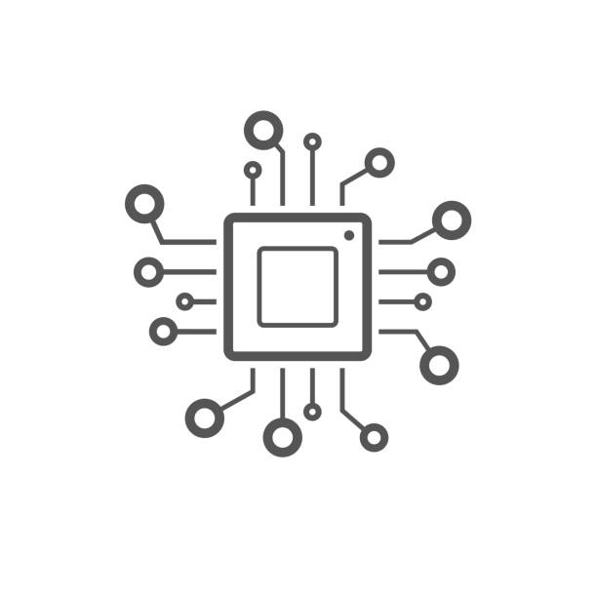



UART
.
.
.
5sec
.
.
.
5sec
.
.
.

Slide 15
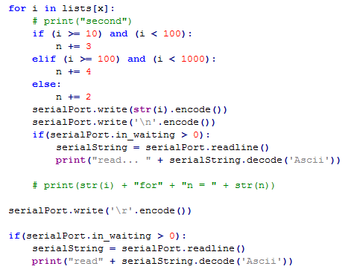
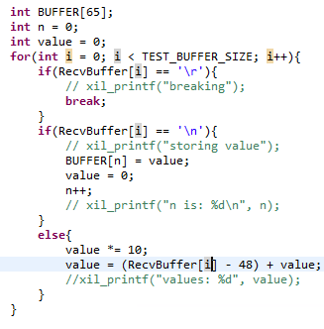
UART number conversion

Slide 16
Video Encoding Hardware IP Cores
in FPGA 1

Slide 17
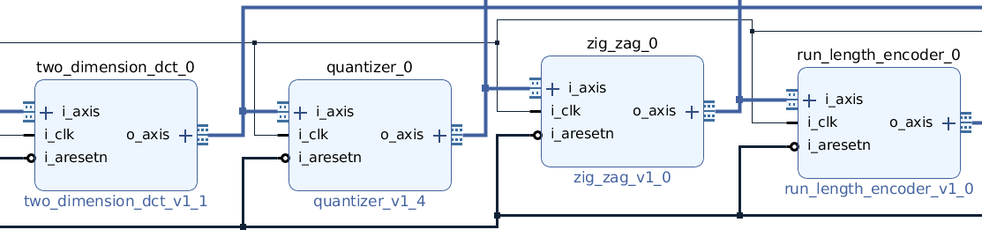
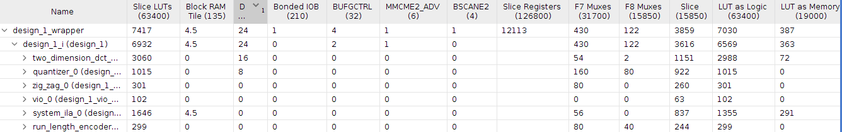
Video Encoding Hardware

Slide 18
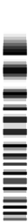
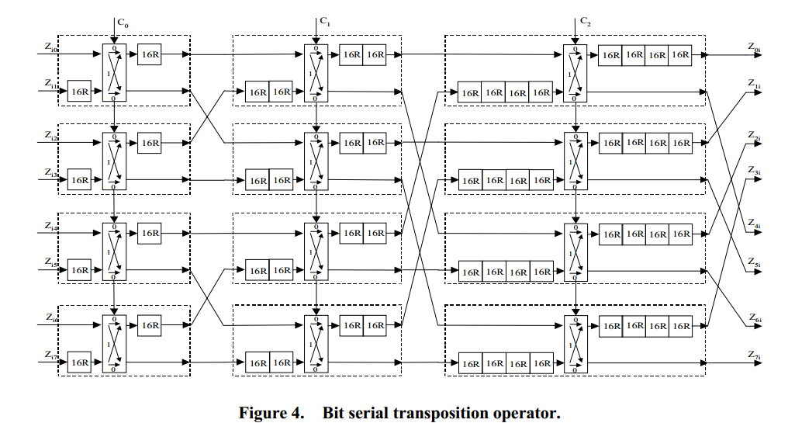
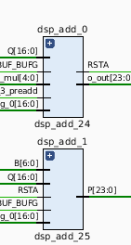
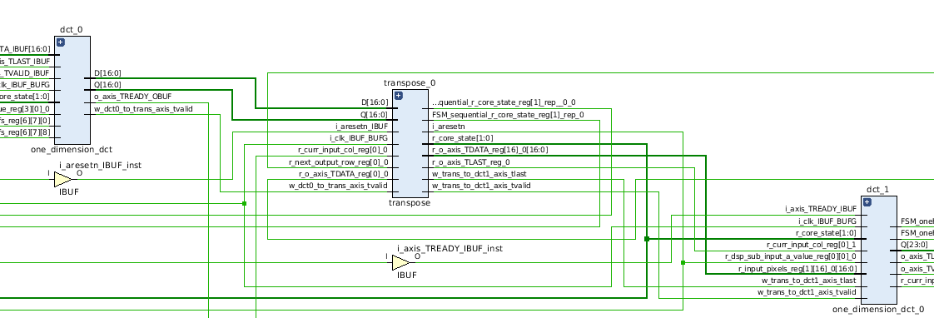
2-D Discrete Cosine Transform (DCT)

Slide 19
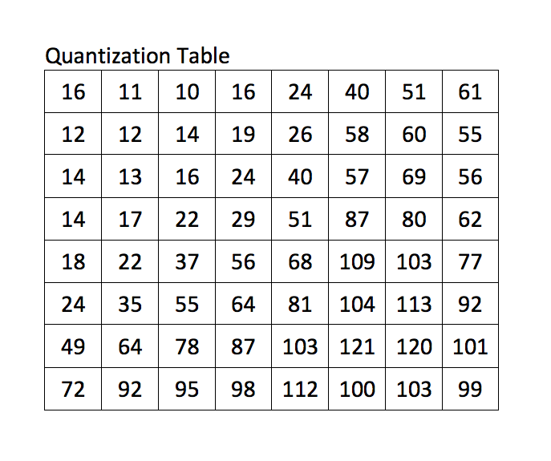
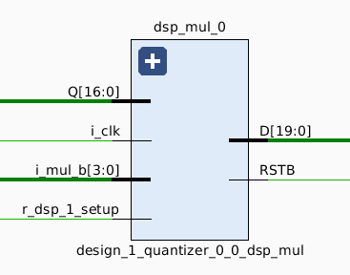
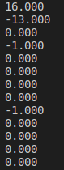
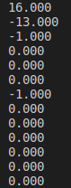
Quantizer and Zig-Zag

Slide 20
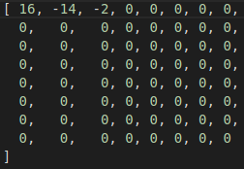

Entropy Coding

Slide 21
Video Decoding Using Microblaze in FPGA 2

Slide 22
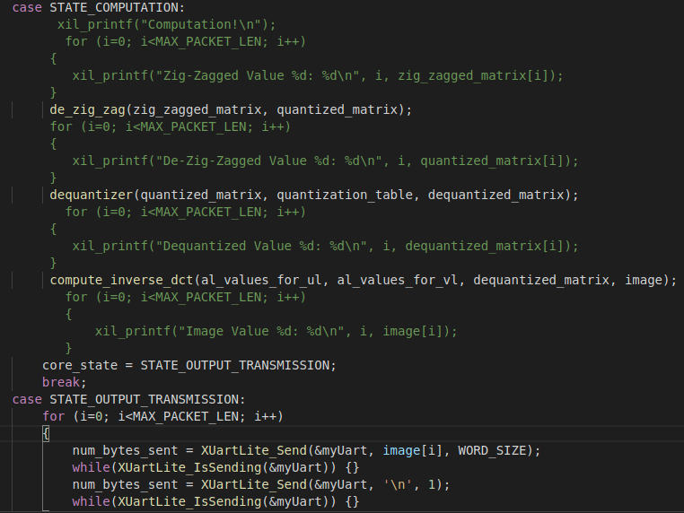
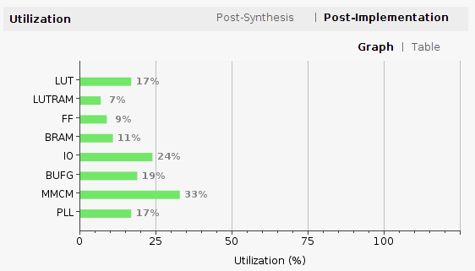
Decoding on Microblaze (FPGA 2)

Slide 23
FPGA 1 to FPGA 2 Communication

Slide 24
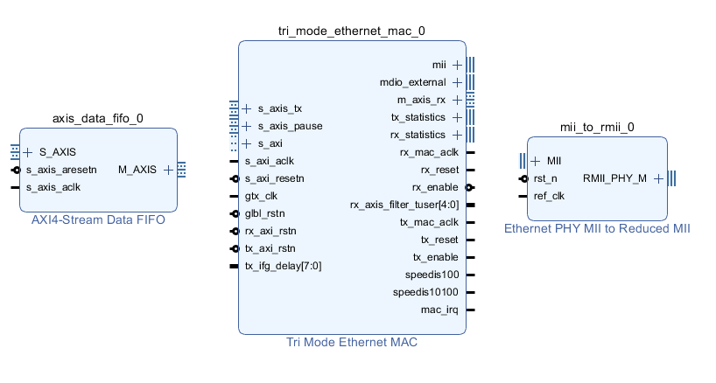
TEMAC
Data coming out of encoder
Data going into the PHY layer

Slide 25
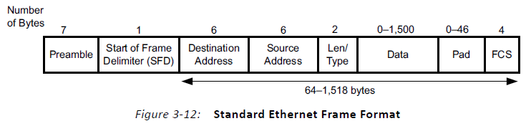
Frame Structure
Frame structure going into TEMAC

Slide 26
Frame Generator and Frame Destroyer
Encoder data
Encoder data packaged in frame structure
Encoder data
Frame Generator
TEMAC
Frame Destroyer

Slide 27
Project Management

Slide 28
Task Assignment and Risk Management
Justin:
Wrote compression algorithm for FPGA1 and decompression algorithm for FPGA2 (Complete)
Risk: Wrote compression algorithm in C before implementing in Verilog, so that a Microblaze could be a potential substitute for the hardware algorithm
Bob:
Modified the TEMAC example design to transmit data from FPGA 1 to FPGA 2 (Complete)
Created first iteration of “frame generator” (Complete)
Risk: Alternative is to use LWIP, however attempting to use 2 Microblazes in one project is a also a big risk.
Isamu:
Prepare Python script that will break apart an image and prepare packets which contain the pixel values of each block (Complete)
Figuring out the UART connection and interface between command line and Microblaze via SDK (Complete)
Connect data on Microblaze and feed to IP cores via AXIS FIFO (Complete)

Slide 29
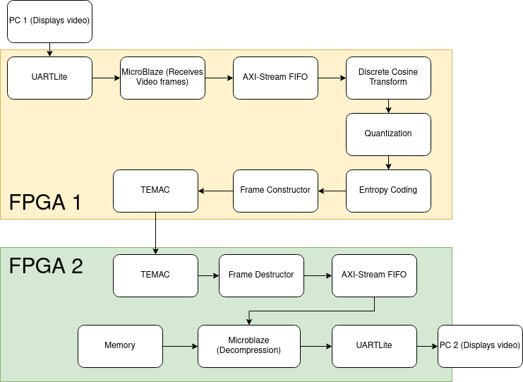
Project Progress
Complete
Partially Working
Incomplete

Slide 30
What’s Left
TEMAC:
Fix bug: Transmitter FIFO is not outputting data (Incomplete)
FPGA2 AXI-Stream FIFO-to-Microblaze (AXI-Stream FIFO):
Fix bug: Reading packet data interferes with FIFO’s Receive Length Register (Incomplete)
Workaround: Reconstruct packets in Microblaze using encoded coefficients (Complete)
Fix bug: AXI-Stream FIFO sometimes stops transmitting data (Incomplete)
FPGA2-to-PC2 Connection (UARTLite):
Include carriage return characters in packets to separate pixel values (Incomplete)
PC2 Post-Processing (PC2):
Receive data from COM port (Incomplete)
Perform fixed->float conversion and display image (Incomplete)

Slide 31
Problems We Encountered
IP performance changed when implemented on hardware
Used ILA to track signals and isolate issues
Followed coding practices for synthesizable Verilog
Hardware cores don’t meet timing constraints
Use Vivado to find critical paths, then alter them or switch them to DSP’s
Hardware cores use too many resources
Reduce parallelism to reduce utilization at cost of performance
Unexpected behaviour due to equipment malfunctions
When unexpected behaviour occurs, switched machines or worked locally
Time-Consuming to implement UART and FIFO
Reference designs lacked detail, and no existing examples sent large amounts of data over UART using Pyserial

Slide 32
Open Source

Slide 33

Open Source
Observation: Online there is little access to hardware implementations of image/video compression. The following will be very useful to future developers:
Custom hardware IP cores for each component of the H.263 algorithm with DSP usage
UART connection to send large numbers of packets over serial port without loss of information
AXIS FIFO integration with UART
TEMAC implementation between connecting between 2 FPGAs
The above code and documentation explaining how to use them will be released publicly in our following repository: https://github.com/isamumu/ECE532
IDEA: With the above implementations released, it will give developers an easier time debugging and allow them to build more complex systems due to less risk of debugging.

Slide 34
What We Learned
Implementing UART to send numerous packets over serial communication is not trivial
Not guaranteed that UART will catch the packets in order over the port
Catching the packets at different times cause data to get caught halfway through transmission
UART FIFO requires designer to know how much data to send
Easier to use Xilinx drivers to send data from UART -> FIFO -> IP cores
Troublesome to send data from IP core -> FIFO -> microblaze
H.263 hardware Implementation requires many resources
Should employ DSPs to reduce LUT utilization and to meet timing constraints
Reduce parallelism to reduce utilization at cost of performance
TEMAC Implementation is non-trivial
IP Core examples were virtually absent online, so it was very difficult to debug
One obstacle is to connect two FPGAs with the TEMAC. Another obstacle is to get it working with other IP cores
Bottlenecks:
Third party cores (TEMAC and AXIS FIFO) can be very difficult to integrate due to opacity and unexpected bugs.

Slide 35
Demo

Slide 36
Q & A

Slide 37
Project Complexity
Data transfer over USB
Transfer data from Desktop to FPGA using UART + MicroBlaze + python script (0.25 points).
Desktop to FPGA network connection
Connect using raw IP/MAC packet from python script (0.25 points).
FPGA network connectivity
Connect to the network without using MicroBlaze, direct connection from hardware (0.5 point).
IP Core implemented in FPGA Hardware
Implement the IP core with a complexity point of at least (1 point).
Performance monitoring
Implement performance monitoring in MicroBlaze with multiple network connectivity types (0.25 points).
Software algorithm implemented on MicroBlaze
Difficulty scales with complexity of algorithm (assume 0.1 points).
Meaningful visualization of program run/statistics gathered/results obtained
Visualize meaningful results with a GUI (0.75 points).
Total complexity score : 3.1 points.

